Slide 1
TWITTER SENTIMENT ANALYSIS
A Data Science Project

Slide 2
PROJECT BY
Waseem Khalid (FA17-BSE-035)
Mahad Naveed (FA17-BSE-111)

Slide 3
TABLE OF CONTENTS
DATA
PROCESS
RESULT
GATHER DATA
CALCULATING
GRAPH
CLEANING THE DATA
CALCULATING THE SENTIMENT
SHOW THE RESULT IN GRAPHICAL FORM

Slide 4
WHY TWITTER?
TWITTER IS MICROBLOGGING WEBSITE WHERE USERS COMMUNICATES THROUGH TEXTUAL FORM CALLED ‘TWEETS.’

Slide 5
PROCESS
OCTAPARSE
TEXTBLOB
DATA CLEANING
GRAPHICAL REPRESENTATION
TWEETS EXTRACTION
SENTIMENT ANALYSIS
RE.
MATPLOTLIB.PYPLOT
TWEETS EXTRACTED BY OCTAPARSE
TWEETS’ SENTIMENT ANALYZED BY BUILT IN FUNCTIONS OF TEXTBLOB
DATA CLEANED BY LIBRARY RE. TO REMOVE UNNCESSARY INFORMATION
SENTIMENT CALCULATED AND SHOWIN IN GRAPHICAL FORM

Slide 6
DATASET
DATASET FOR THIS PROJECT WAS EXTRACTED
FROM FOLLOWING TWITTER HANDLE:
https://twitter.com/whatthemahad

Slide 7

DATA EXTRACTION
ALL THE TWEETS WERE EXTRACTED USING FREE WEB USUAL APPLICATION ‘OCTOPARSE.’
https://www.octoparse.com/

Slide 8
DATA CLEANING
JUNK DATA:
MENTIONS
HASHTAGS
RETWEETS
HYPERLINKS

Slide 9
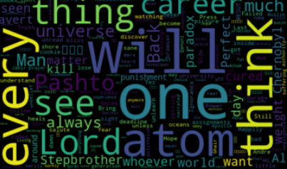
WORDCLOUD
VISUAL REPRESENTATION OF VISUAL DATA, MOSTLY KEYWORD METADATA.

Slide 10
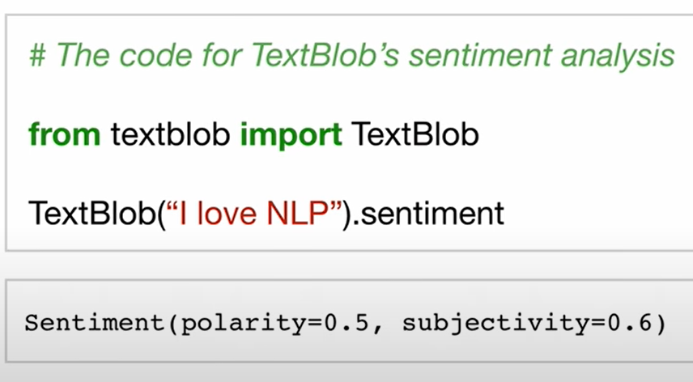
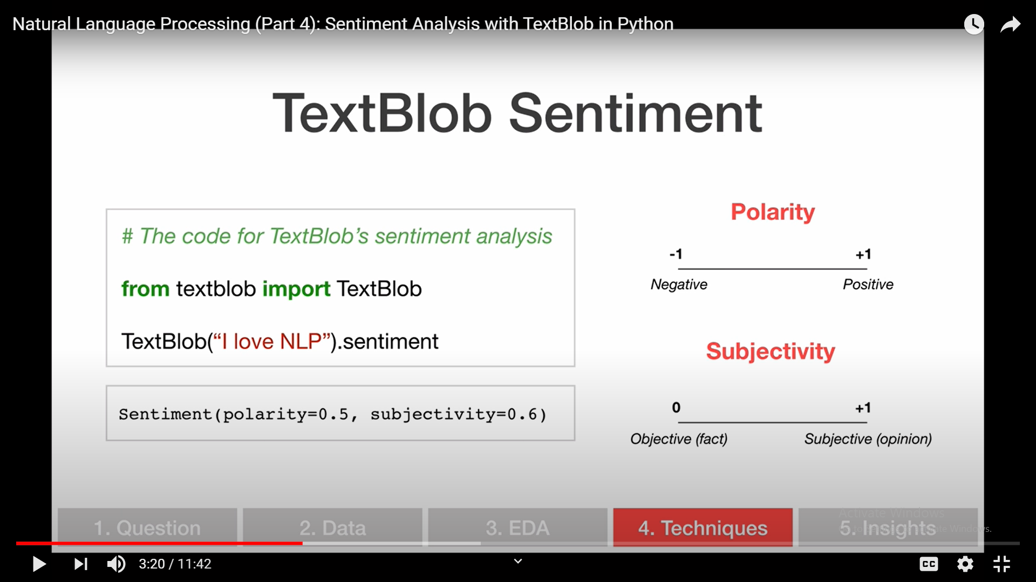
TEXTBLOB
TEXTBLOB IS PYTHON LIBRARY BUILT OVER
NLTK LIBRARY.

Slide 11
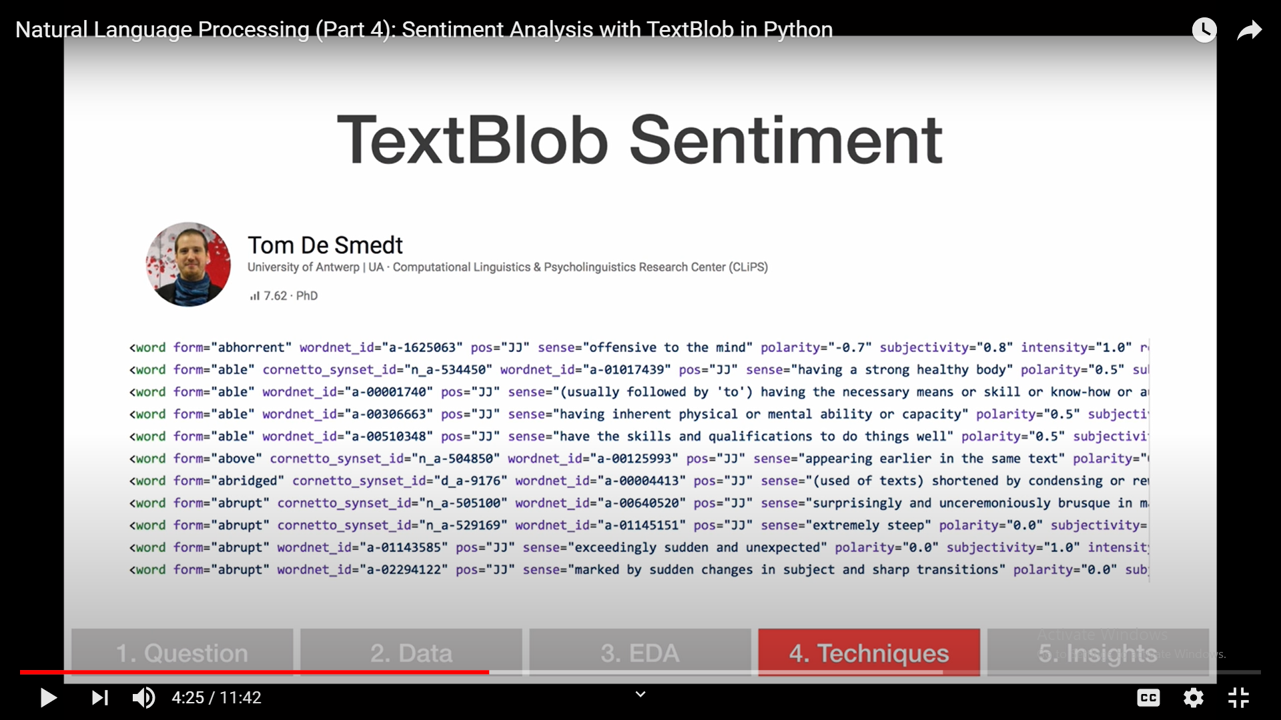
TEXTBLOB SENTIMENT

Slide 12
SENTIMENT ANALYSIS
SUBJECTIVITY
POLARITY
SUBJECTIVE SENTENCE REFERS TO OPINION, EMOTION AND JUDJEMENT.
LIES BETWEEN [0,1]
THE SENTIMENT PLOARITY CAN BE DETERMINED AS POSITIVE, NEGATIVE AND NEUTRAL.

Slide 13
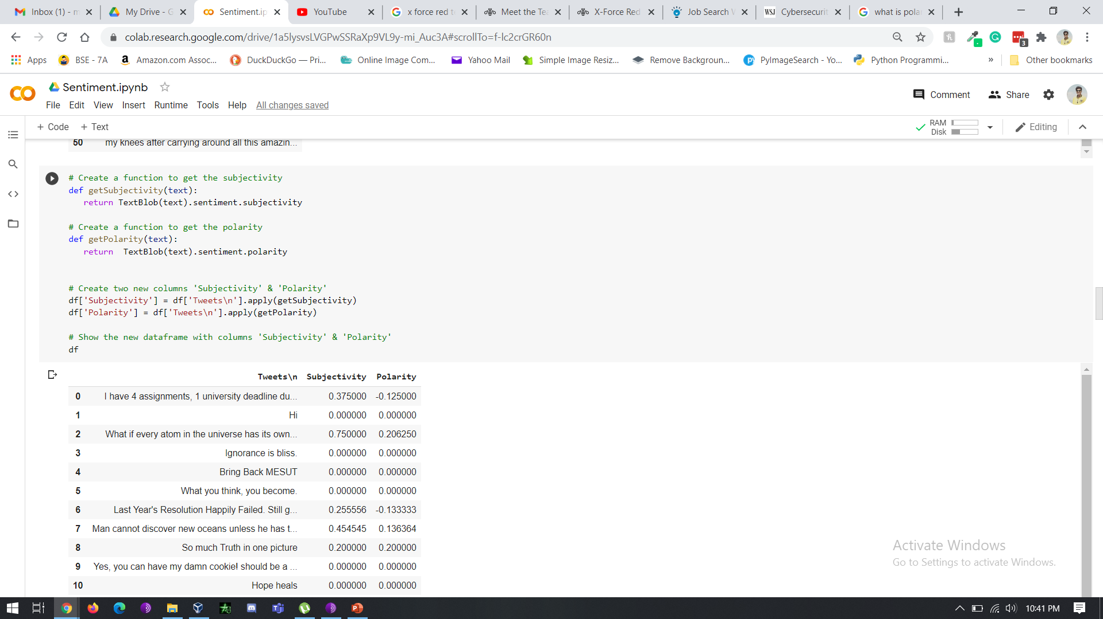
SUBJECTIVITY AND POLARITY

Slide 14
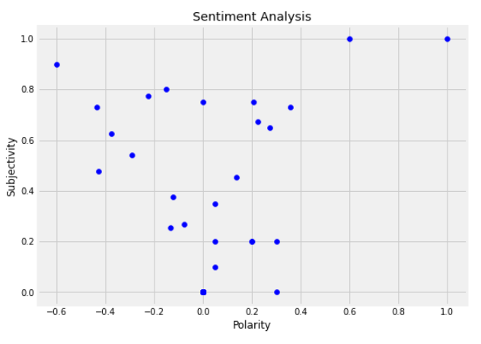
PLOTTING
VISUAL REPRESENTATION OF VISUAL DATA, MOSTLY KEYWORD METADATA.

Slide 15
TEXT SENTIMENT
POSITIVE
NEAGTIVE
NEUTRAL
27.5%
19.6%
52.9%

Slide 16
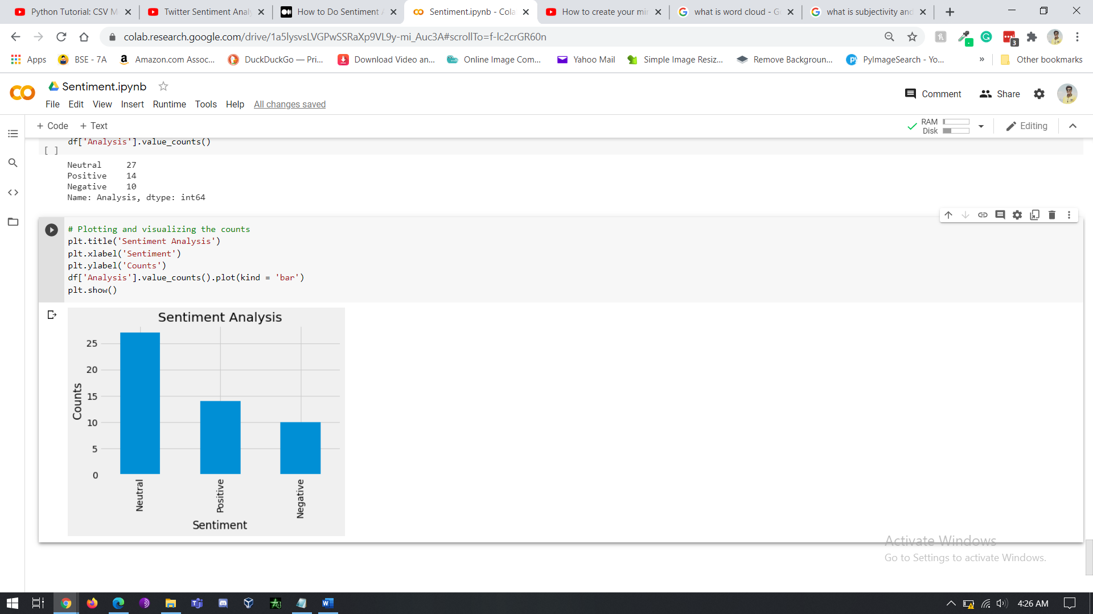
SENTIMENT ANALYSIS
FINAL REPRESENTATION OF SENTIMENT DATA IN GRAPHICAL FORM

Slide 17
PRACTICAL APPLICATIONS
MARKETING
TEXT TOOLS
ELECTION CAMPAIGN
PRODUCT LAUNCH
Marketing agencies can predict sentiments by their compaigns.
Text tools like Grammarly can predict sentiment.
Social Media can directly predict what someone likes and dislikes.
Companies can get indirect feedback from customers.

Slide 18
THANK YOU!
Do you have any questions?

